Slide 1
moose for dcs world detection & task dispatching
ALPHA RELEASE
based on a
Concept created by
mechanist (Gábor)
and in joint development with with moose framework community

Slide 2
DETECTION
BASE
Build sets of detected objects within the battle zone using defined detection method(s)
DETECTION _BASE
DETECTION _AREAS
…
SPAWN
SPAWN
SET_GROUP

Slide 3
detection of units
RECON
B
A
Detect one SET of UNITs within an optional range.
D
C

Slide 4
explanation of symbols used
Identities
Friendly Ground
Hostile Ground
Friendly Air
Hostile Air
Military Helicopter
Military Fixed-Wing
Anti Tank
Recon
Main
Icons
Armored
Anti Air
Artillery
Infantry
Missile
Supply
(drawn at lower half)
Motorized
(drawn at middle)
Air Mobile
(drawn at lower half)

Slide 5
DETECTION_AREAS
RECON
B
Detect UNITs within range, and group these units into multiple SETs of units within an area range.
D
A
C

Slide 6
the DETECTION classES main purpose
DETECTION of objects within the battle zone
DETECTION_BASE implements the base logic and methods to detect objects within the battle zone, using defined detection method(s) within an optional detection range.
The GROUP(s) provided to DETECTION_BASE will be detecting the objects.
DETECTION_BASE provides a polymorphic method to build an array of SET_BASE, containing the detected objects.
Derived class DETECTION_AREAS builds a table of SET_UNITs, grouped in AREAS of (multiple) detected objects.
BASE
DETECTION _BASE
DETECTION _AREAS
…
SPAWN
SPAWN
SET_GROUP

Slide 7
use cases – start situation
B
AREA 1
A
AREA 2
The reconnaissance detects:
A defining AREA 1 with range.
B added to AREA 2.
D defining AREA 2 with range.
C added to AREA 2.
D
C
A

Slide 8
event 1 : unit moves and remains in set
B
AREA 1
A
AREA 2
The reconnaissance detects:
B moves in AREA 1.
D
C
A

Slide 9
event 2 : new detected unit and part of an existing set
B
AREA 1
A
AREA 2
The reconnaissance detects:
E is newly detected and added to AREA 1.
D
E
C
A

Slide 10
event 3 : unit becomes undetected and is removed from existing set
AREA 1
A
AREA 2
The reconnaissance detects:
B becomes undetected due to invisibility and is removed from AREA 1.
D
E
C
A

Slide 11
event 4 : leader unit becomes undetected
AREA 2
The reconnaissance detects:
B becomes undetected due to invisibility and is removed from AREA 1.
D
E
C
A
AREA 1

Slide 12
event 5 : new unit is detected outside of existing zone
AREA 3
F
AREA 2
A is removed from AREA1.
E becomes the new lead of AREA1.
D
E
C
A
AREA 1

Slide 13
event 6 : unit is moving into other detected zone
AREA 3
F
C
A
AREA 2
C moves to AREA3.
D
E
AREA 1

Slide 14
event 7 : leader unit is movIng into other detected zone
AREA 3
F
C
A
AREA 2
E moves to AREA2.
AREA1 is deleted (no targets), and E is merged into AREA2.
D
E

Slide 15
DETECTION DISPATCHing
MISSION
DETECTION_
MANAGER
Dispatch TASKS of detected areas of units by Forward Air Controllers to Head Quarters and dispatch TASKS to defined attack groups within one MISSION.
SET_GROUP
DETECTION_
REPORTING
DETECTION_
DISPATCHER
DETECTION_
AREAS
TASK_SEAD
GROUP
TASK_BASE

Slide 16
the DETECTION DISPATCHER main purpose
DETECTION of objects within the battle zone
Now that we understand DETECTION based classes, the DETECTION_DISPATCHER is responsible for handling the detected objects, turning them into TASKS.
Derived classes from DETECTION_MANAGER will implement the actions to be taken with the SETs built by DETECTION_BASE.
For example, DETECTION_REPORTING and DETECTION_DISPATCHER are both classes that are handling the actions with detected units.
DETECTION_DISPATCHING provides command options to a SET of GROUPS for executing and accepting tasks as a result of the DETECTION.
DETECTION_
MANAGER
MISSION
LOGICAL MISSION
SET_GROUP
DETECTION_
REPORTING
DETECTION_
DISPATCHER
ATTACK GROUPS
DETECTION_
AREAS
TASK_SEAD
TASK_BASE
GROUP
SEAD TASK
CAS TASK
BAI TASK
JTAC TASK
CSAR TASKs
HEAD QUARTERS

Slide 17
fac - detecting targets using the area detection method
E
2 Reconnaissance vehicles R1 and R2 are detecting targets using DETECTION_AREAS.
R1 detects A and B, and defines an AREA 1.
R2 detects C and D, and defines an AREA 2 and 3.
2 Attack Helicopters are in the air awaiting orders.
A
AREA 1
R1
B
A
H1
R2
AREA 3
A
D
C
H2
A
AREA 2

Slide 18
fac – report detected targets to hq
E
R1 reports AREA 1 to HQ.
R2 reports AREA 1 and 2 to HQ.
A
AREA 1
R1
B
A
H1
R2
AREA 3
A
A1
A
B
A2
A3
D
C
D
C
H2
A
AREA 2
HQ

Slide 19
hq – ASSIGN TASKS TO groups
E
HQ defines CAS, SEAD and BAI tasks, and communicate them to GROUP1 and GROUP2.
A
AREA 1
HQ defines a CAS for A1 because of nearby friendlies.
R1
B
P1
A
C
GROUP2
H1
GROUP1
R2
AREA 3
HQ defines BAI tasks for A2 and A2 because there are no friendlies.
A
A1
A
B
D
CAS
A2
C
SEAD
C
H2
BAI
A3
B
D
HQ defines SEAD task(s) because of RADAR presence.
HQ
AREA 2

Slide 20
GROUPS – select tasks and attack
E
GROUP 1 selects the CAS and BAI tasks.
GROUP 2 selects the SEAD tasks.
A
AREA 1
R1
B
P1
A
C
GROUP2
H1
GROUP1
R2
AREA 3
A
SEAD
CAS
D
BAI
C
H2
B
AREA 2
HQ

Slide 21
INTERFACE DURING BATTLE

Slide 22
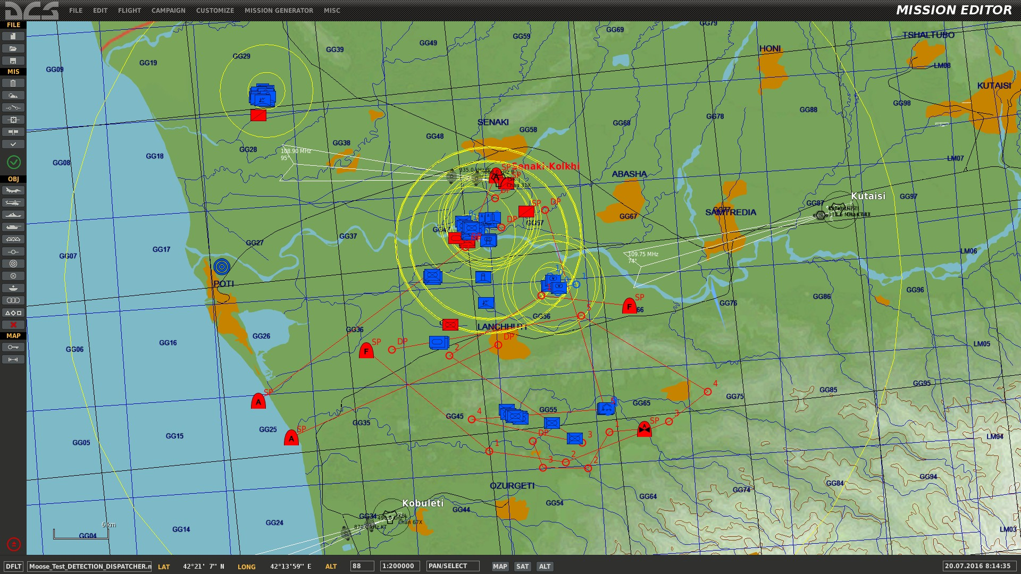
battle scene overview
1
Red against blue
1
2
Red ground FACs detecting blue targets
4
3
Red AFACs detecting blue targets
2
4
3 red attack GROUPS
3
4

Slide 23
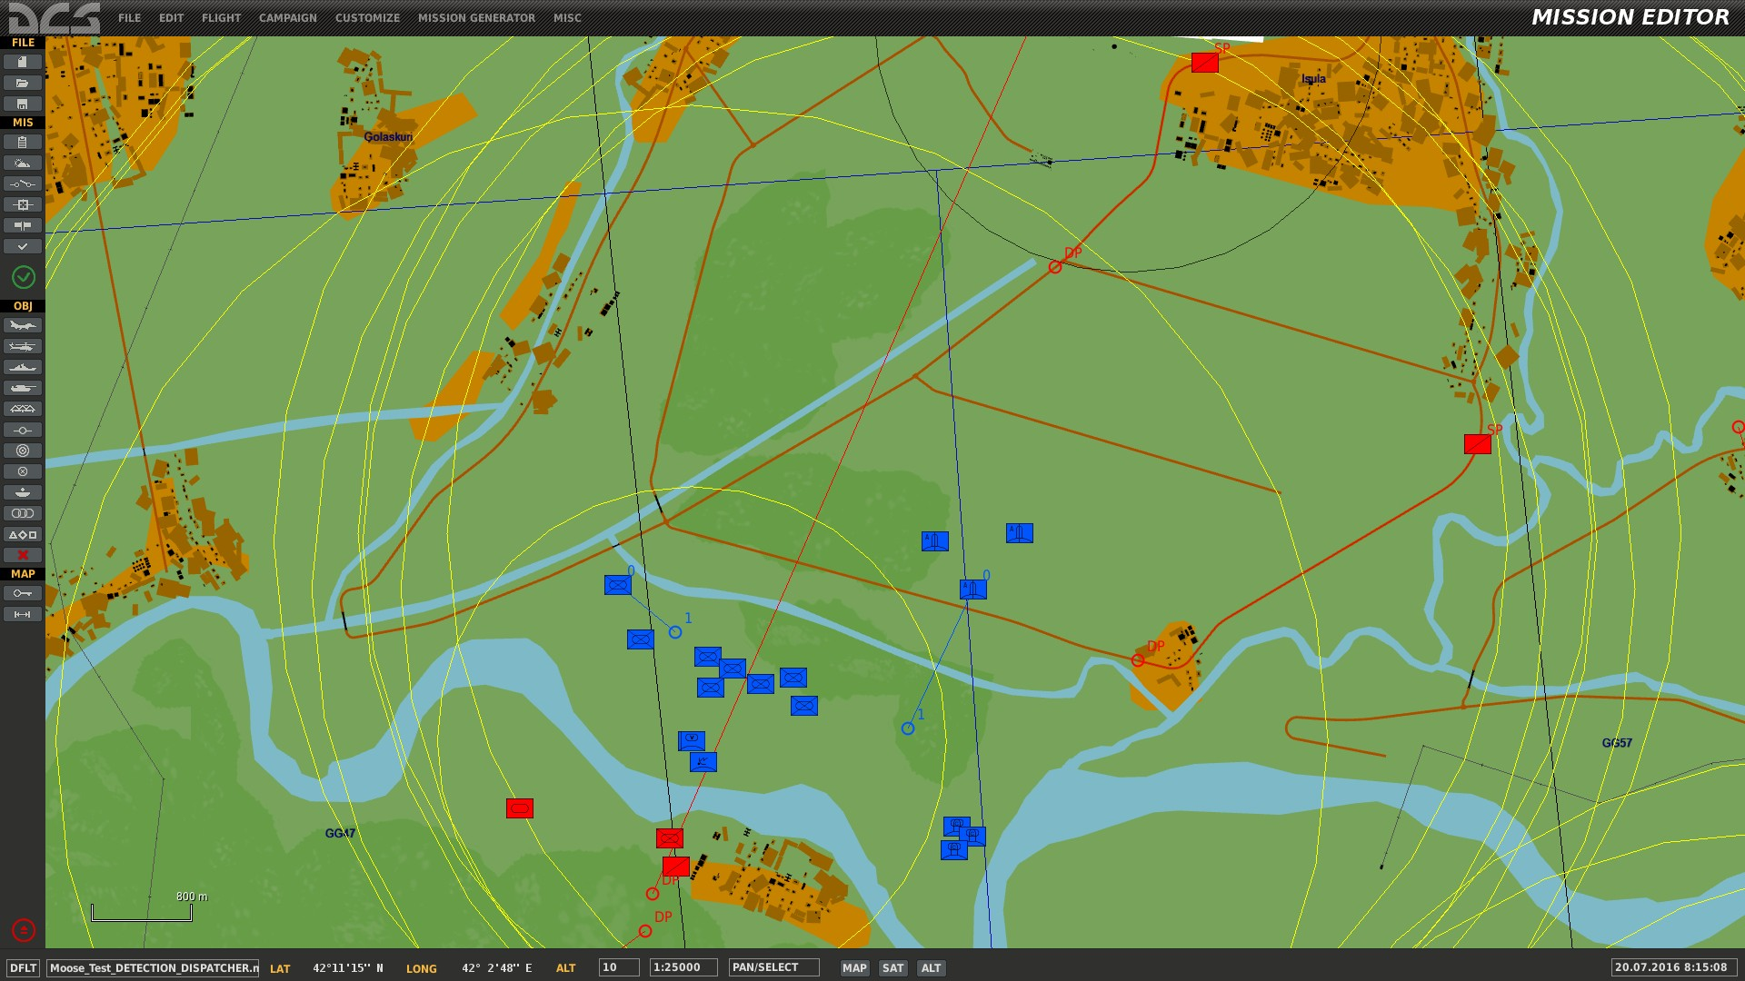
battle scene overview
1
Red ground FACs detecting blue targets
2
Friendlies are nearby the areas.
3
The blue forces are spread out and are of different unit types.
1
3
5
4
There are SAMs with SRs and TRs (HAWKS).
4
5
There are blue SAMs with IR capability.
5

Slide 24
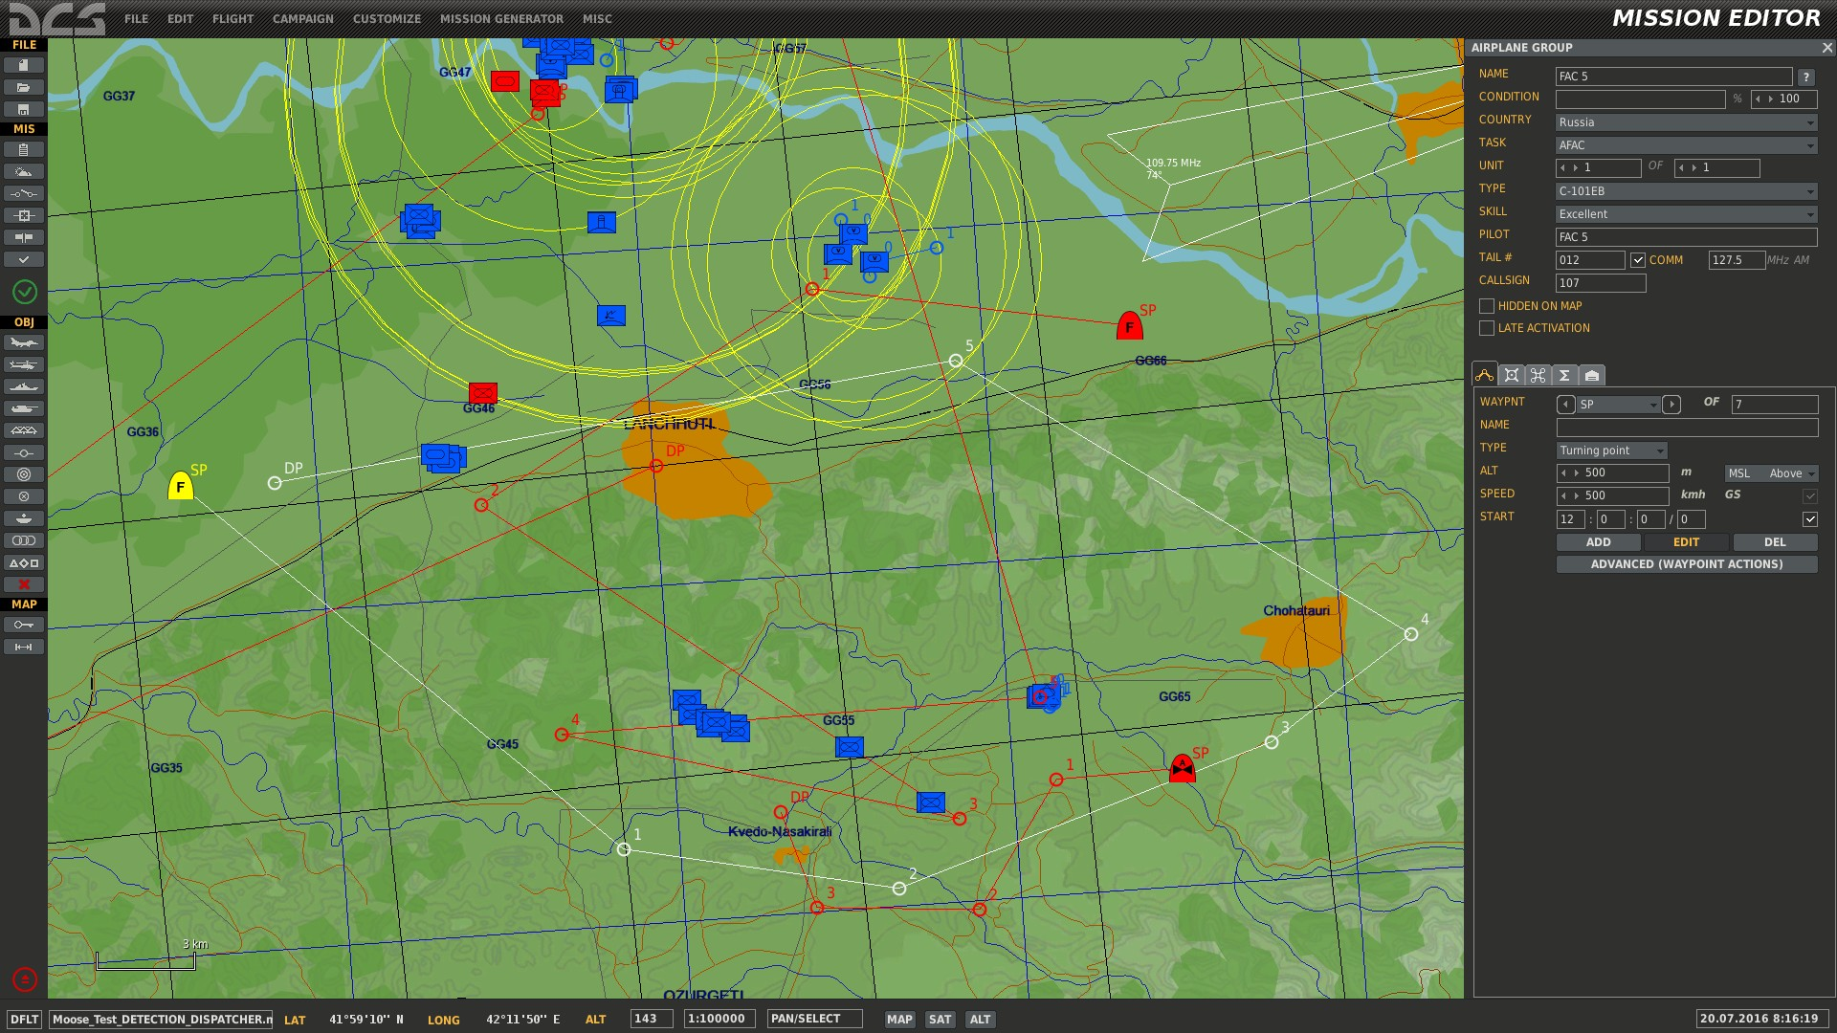
battle scene overview
1
Red airborne AFACs detecting blue targets
2
There are blue forces without friendlies nearby.
2
1

Slide 25
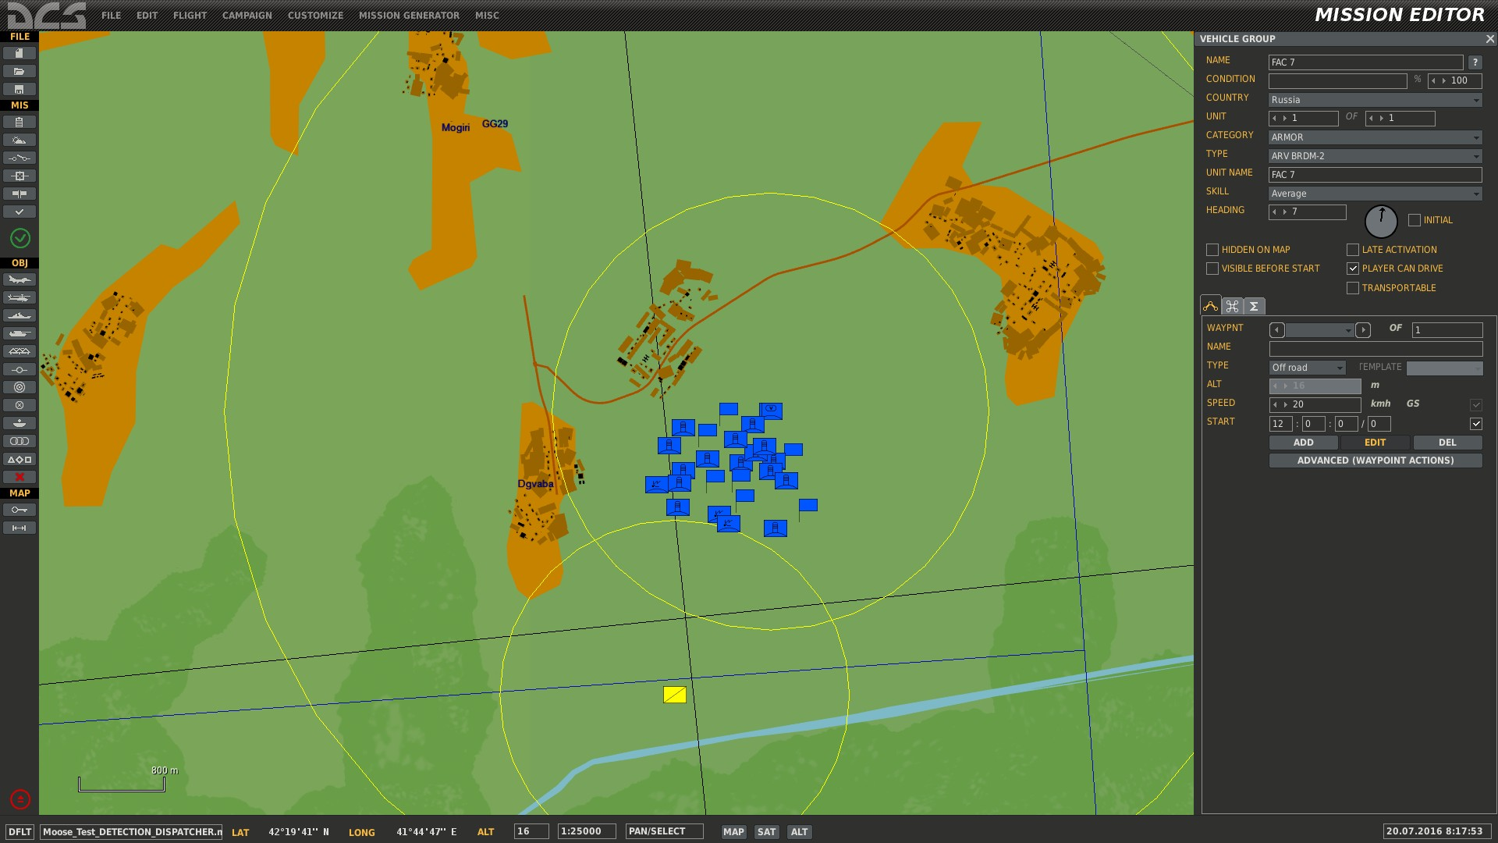
battle scene overview
1
A large PATRIOT battery is located in teh north.
2
A red FAC is detecting the area.
1
2

Slide 26
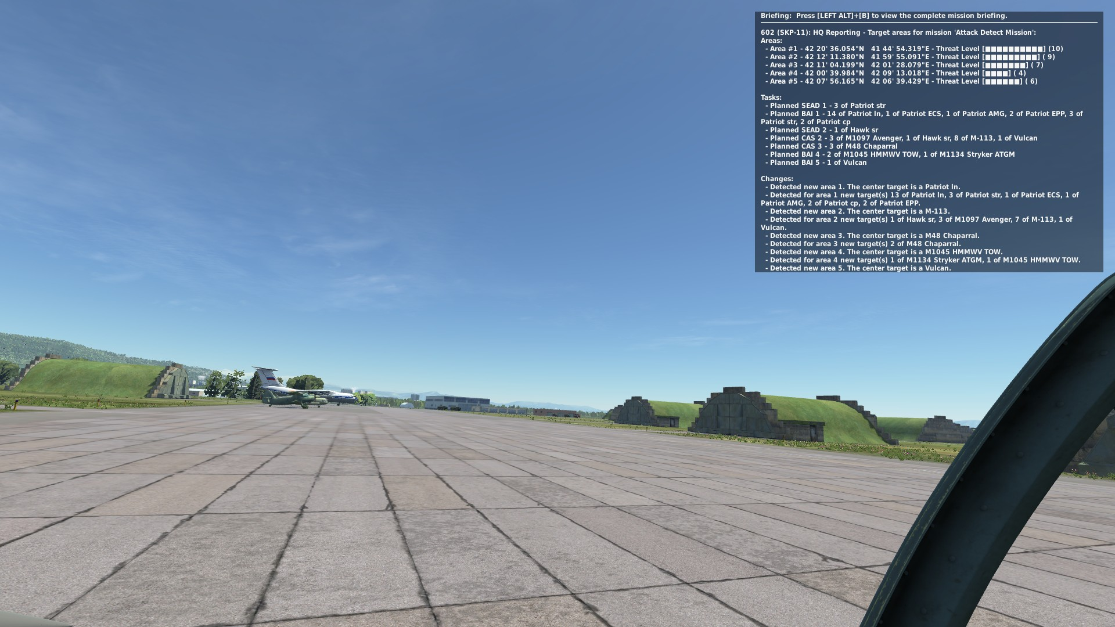
groups will receive taskings from hq
1
The Head Quarters (HQ) reporting tasks
2
We joined GROUP “Attack Theta” in an SU-25T to observe the tasking orders sequence.
1
2

Slide 27
each area is assigned a threat level
10
Long Range SAMs with Search and Tracking Radars.
9
Medium Range SAMs with Search and Tracking Radars.
8
Short Range SAMs with Search and Tracking Radars.
7
Short Range SAMs and MANPADS with Infrared Missiles.
6
Anti Aircraft Artillery
5
Modern Battle Tanks.
4
Battle Tanks and Infantry Vehicles with ATGM.
3
Battle Tanks and Infantry Vehicles without ATGM.
2
Old Tanks and APCs.
1
Infantry.

Slide 28
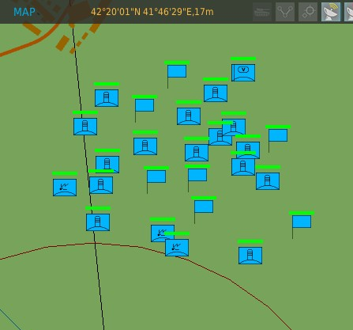
each area is reported coordinates
1
1
Each Area is reported with Latitude and Longitude coordinates

Slide 29
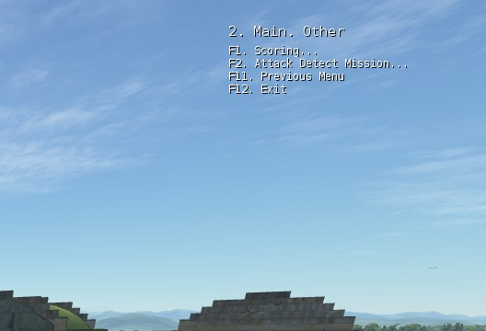
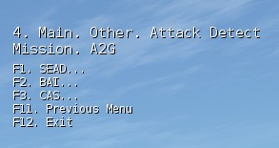
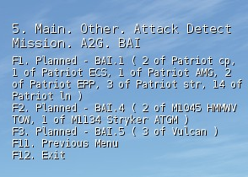
A tasking menu is created at each detection report
1
A new Tasking is created at each detection scan.
4
2
The Tasking Menu is located under “F10. Other” menu items.
3
3
Multiple MISSIONS that mayb be defined, have each their own Tasking Menu.
4
Optionally a SCORING can be added at each MISSION, which will account hits, kills, tasking and mission achievement scores.
5
5
Multiple task types are listed, going through the Menu. After selection of a task type, each task is listed.
6
As the MOOSE framework will evolve, more task types will be added ( CSAR, Transport, JTAC ) …

Slide 30
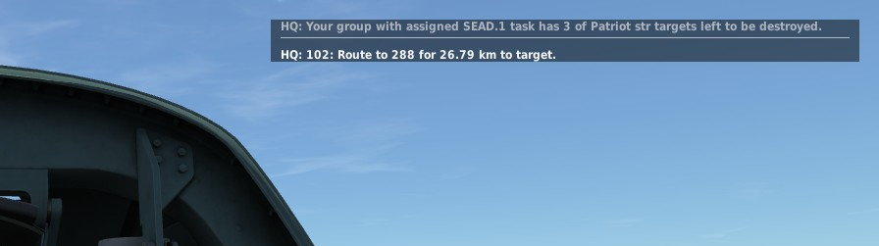
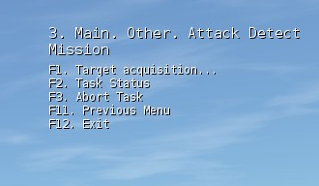
a selected task moves the group in assigned mode…
1
Once a target has been selected, the GROUP you are flying for goes in “ASSIGNED MODE”.
1
2
The tasking menu has changed in assigned mode. Relevant Task Menu options are displayed for the specific Task you selected.
3
2
3
You will receive specific task directions and target goal achievements. Status messages are also displayed.

Slide 31
coding

Slide 32
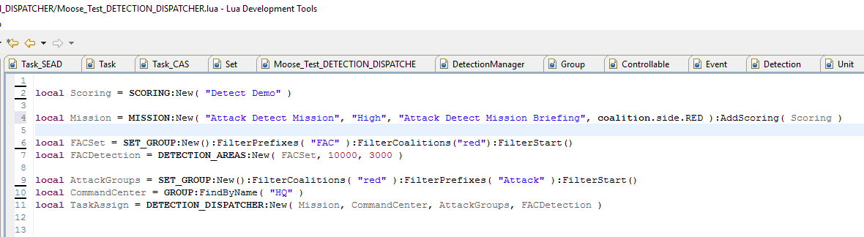
How to code all this …
Line 2 defines the scoring, using the SCORING class.
Line 4 defines a MISSION, with the name “Attack Detect Mission”, “High” priority, and a mission briefing, for the RED coalition.
Line 6 defines the GROUP of FACs, starting with the prefix “FAC” in the ME.
Line 7 creates the DETECTION_AREAS process, for the defined FACs, with a detection range of 10000 meters, and defining areas of 3000 radius.
Line 8 defines the set of GROUPS that are attacking the targets.
Line 10 defines the Head Quarters GROUP, which will collect and dispatch the tasks to the Attack GROUPS.
Line 11 creates the DETECTION_DISPATCHER process, taking the MISSION, HQ, Attack GROUPS and the DETECTION_AREAS object. Thats is …

Slide 33
WRAP up

Slide 34
consult the online documentation
All class and API descriptions on the MOOSE GITHUB pages.
There are online training videos available on my YOUTUBE CHANNEL.
The documentation explains:
How to use MOOSE and install it in your mission.
The directory structure of the MOOSE pack.
Classes are embedded in lua “modules”. Eg. the zone classes are collected in the lua module Zone.
A CLASS in the lua documentation is sometimes referenced by Module#CLASS.
The Module is sometimes not given, so #CLASS references to a class within the current module. All these references are clickable, so within the documentation, it is possible to move back and forth through the explanations.

Slide 35
Training missions
Each of the classes have Example Test Missions!
Find in the MOOSE pack or on GITHUB the relevant directories:
Moose_Test_DETECTION
Moose_Test_DETECTION_DISPATCHER
… (more will be added later).
Each of these directories contain:
A DCS World .MIZ file containing an executable mission.
The .LUA file containing the example code using the zone class (and other classes).

Slide 36
HOPE YOU FOUND THIS INTERESTING
You can reach me on SKYPE with the ID: FlightControl_Skype
Or, join the SLACK.COM development community at
https://flightcontrol.slack.com/messages/moose/

